Slide 1
Tittle cyclistic analysis report

Slide 2
Business Task
The business task is to analyze how annual members and casual riders use Cyclistic bikes differently. Design marketing strategies aimed at converting casual riders into annual members.

Slide 3
Data Sources
https://divvy-tripdata.s3.amazonaws.com/index.html

Slide 4
Data Cleaning and Manipulation
Merged monthly datasets into a single worksheet.
Ensured consistent column names (e.g., ride_length for trip duration).
Converted date-time columns to separate date and time fields.
Calculated ride length in minutes for all trips.
Filtered out anomalies
Created a day_of_week column to label trips from Monday to Sunday.
Aggregated data for average and count of trips by user type and day of week.

Slide 5
Summary of Analysis
Casual riders have fewer total trips compared to members, but their ride lengths tend to be longer.
Members show consistent high usage during weekdays, especially Thursday and Friday.
Casual riders tend to ride more during weekends, suggesting spare time use.
Members peak usage suggests commuting patterns, while casual riders show tourism/leisure trends

Slide 6
Data Visualization
Bar chart showing trip counts by day of week for both members and casual riders.
A second visualization (recommended) could compare average ride length by user type and day of week.
A third visualization could show total trips per month to detect seasonality.

Slide 7
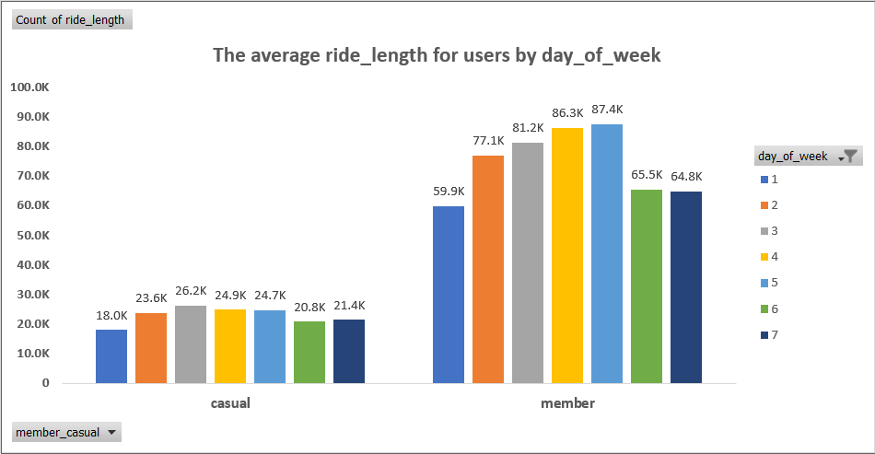
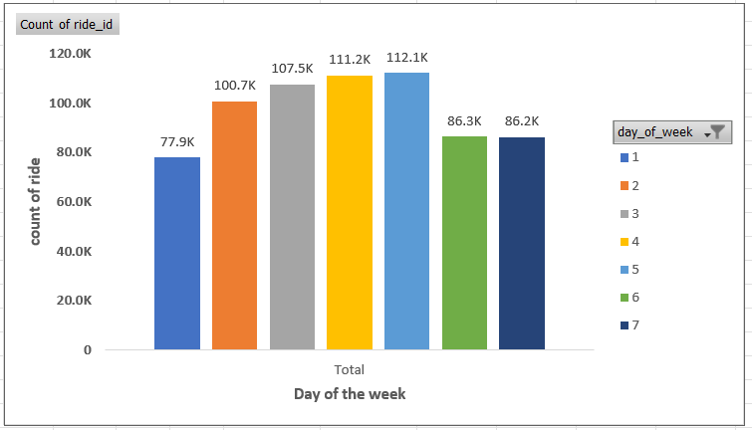

Slide 8
Key Findings
Weekend preference: Casual riders use bikes more on weekends, members on weekdays.
Ride duration: Casual riders average longer trips than members, likely due to leisure purposes.
Member consistency: Members maintain steady usage patterns across the week, indicating daily commuting habits.

Slide 9
Recommendations
Target weekend riders Launch weekend membership trial offers or “weekend pass upgrades” for casual riders to encourage commitment.
Highlight savings for long rides Since casual riders take longer trips, emphasize cost savings in marketing messages for annual memberships.
Leverage digital channels strategically Promote memberships via geotargeted ads around popular weekend riding locations, using social media campaigns with local event tie-ins.

